Slide 1
Computer Architecture & NETWORKS
CHAPTER 2:
NUMBER SYSTEMs

Slide 2
LEARNING OUTCOMES
This chapter discusses about number systems.
To understand the conversion of number systems in computational methods.

Slide 3
Content
Introduction to number systems:
Binary > 0 - 1
Octal > 0 - 7
Hexadecimal > 0 - F
Decimal > 0 - 9

Slide 4
System | Base | Symbols
Decimal | 10 | 0, 1, … 9
Binary | 2 | 0, 1
Octal | 8 | 0, 1, 2, …7
Hexa-decimal | 16 | 0, 1, … 9, A, B, ... F

Slide 5
NUMBER SYSTEMS
A set of values used to represent different quantities is known as Number System.
A number system can be used to represent the number of students in a class or number of presenters in a session and etc.
The digital computer represents all kind of data and information in binary numbers.

Slide 6
NUMBER SYSTEMS
It includes audio, graphics, video, text and numbers.
The total number of digits used in a number system is called its base or radix.

Slide 7
Type of NUMBER SYSTEM
Decimal Number System
Binary Number System
Octal Number System
Hexadecimal Number System

Slide 8
Decimal number system
The number system that we use in our day-to-day life is the decimal number system.
Decimal number system has Base 10 as it uses 10 digits.
10 symbols : 0, 1, 2, 3, 4, 5, 6, 7, 8, 9
Weightage of each symbol depends on the symbol position
Example :
853₁₀ = (8×10²) + (5×10¹) + (3×10⁰)
The successive positions to the left of decimal point represent units, tens, hundreds, thousands, and so on.

Slide 9
Decimal number system
The position of each digit in a weighted number system is assigned a weight based on the base or radix of the system. The radix of decimal numbers is ten, because only ten symbols (0 through 9) are used to represent any number.
The column weights of decimal numbers are powers of ten that increase from right to left beginning with 10⁰ =1:
…10⁵ 10⁴ 10³ 10² 10¹ 10⁰.
For fractional decimal numbers, the column weights are negative powers of ten that decrease from left to right:
10² 10¹ 10⁰. 10⁻¹ 10⁻² 10⁻³ 10⁻⁴ …

Slide 10
Decimal Numbers
Consider the number 1984
Position 4 3 2 1
Weight 1000 100 10 1
Decimal number 1 9 8 4
1984 = 1 x 1000 + 9 x 100 + 8 x 10 + 4 x 1

Slide 11

Decimal number system
It is the most widely used numeral system.
Position of each digit in a decimal number system carries a weight.
For example: 9781.024 is a decimal number
Each digit 9,7,8,1,0,2,4 carries different weight.
9781.024₁₀ = (9x10³) + (7x10²) + (8x10¹) + (1x10⁰) + (0x10⁻¹) + (2x10⁻²) + (4x10⁻³)
Notes:
Denary or Base 10

Slide 12
Test Yourself:
Express the decimal number 2745.214 as a sum of the values of each digit.

Slide 13
Decimal System
weights
10³
10²
10¹
10⁰
10⁻¹
10⁻²
10⁻³
2
7
4
5
.
2
1
4
2745.214₁₀
= (2x10³)+(7x10²)+(4x10¹)+(5x10⁰)+(2x10⁻¹)+(1x10⁻²)+(4x10⁻³)
= (2x1000)+(7x100)+(4x10)+(5x1)+(2x0.1)+(1x0.01)+(4x0.001)
= (2000)+(700)+(40)+(5)+(0.2)+(0.01)+(0.004)

Slide 14
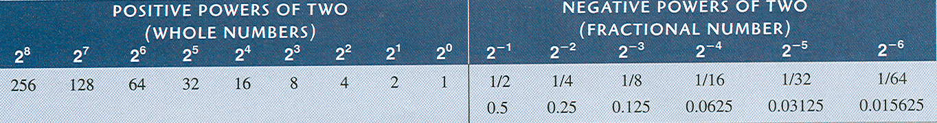
Binary number system
Base 2 number system
Uses two digits: 0 and 1
Each position in a binary number represents a 0 power of the base (2). Example 2⁰
Weightage of each bit depends on the bit position
Example :
1011₂ = (1×2³) + (0×2²) + (1×2¹) + (1×2⁰)
Notes:
Convert the following binary numbers to decimal: i) 1110 ii) 10110 iii) 101001

Slide 15
Binary number system
For digital systems, the binary number system is used. Binary has a radix of two and uses the digits 0 and 1 to represent quantities.
The column weights of binary numbers are powers of two that increase from right to left beginning with 2⁰ =1:
…2⁵ 2⁴ 2³ 2² 2¹ 2⁰.
For fractional binary numbers, the column weights are negative powers of two that decrease from left to right:
2² 2¹ 2⁰. 2⁻¹ 2⁻² 2⁻³ 2⁻⁴ …
Notes:
Convert the following binary numbers to decimal: i) 1110 ii) 10110 iii) 101001

Slide 16
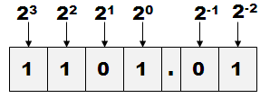
Binary number system
Binary system is used internally by all modern computers.
Similarly to the decimal number system, the position of each digit also carries a weight.
For example, 1101.01
1101.01₂
=((1x2³) + (1x2²) + (0x2¹) + (1x2⁰) + (0x2⁻¹) + (1x2⁻²))₁₀
=((1x8) + (1x4) + (0x2) + (1x1) + (0x0.5) + (1x0.25))₁₀
= ( 8 + 4 + 0 + 1 + 0 + 0.25 )₁₀
= 13.25₁₀
Notes:
Convert the following to binary: i) 55 ii) 89 iii) 150
Repeated subtraction
Repeated division

Slide 17
TEST YOURSELF
Convert the following binary numbers to decimal
01101001

Slide 18
TEST YOURSELF
Convert the following binary numbers to decimal
01101001
=0x128 + 1x64 + 1x32 + 0x16 + 1x8 + 0x4 + 0x2 + 1x1
= 64 + 32 + 8 + 1
= 105₁₀

Slide 19

Octal number system
The octal numeral system uses the digits 0 to 7.
Base 8 number system.
The position of each digit in an octal number can be assigned a weight. Example 8⁰
112₈
= (1 x 8²⁾ + (1 x 8¹⁾ + (2 x 8⁰)
= (64 + 8 + 2)₁₀
= 74₁₀

Slide 20
Octal Numbers
Decimal
Octal
Octal uses eight characters the numbers 0 through 7 to represent numbers. There is no 8 or 9 character in octal.
Binary
0 1 2 3 4 5 6 7 8 9 10 11 12 13 1415
0 1 2 3 4 5 6 7 10 1112 13 14 15 16 17
0000 0001 0010 0011 0100 0101 0110 0111 1000 1001 1010 1011 1100 1101 1110 1111
Binary number can easily be converted to octal by grouping bits 3 at a time and writing the equivalent octal character for each group.
Express 1 001 011 000 001 110₂ in octal:
Example
Group the binary number by 3-bits starting from the right. Thus, 113016₈
Solution

Slide 21
Octal Numbers
Decimal
Octal
Binary
Octal is also a weighted number system. The column weights are powers of 8, which increase from right to left.
0 1 2 3 4 5 6 7 8 9 10 11 12 13 1415
0 1 2 3 4 5 6 7 10 1112 13 14 15 16 17
0000 0001 0010 0011 0100 0101 0110 0111 1000 1001 1010 1011 1100 1101 1110 1111
{
8³ 8² 8¹ 8⁰
Column weights
512 64 8 1
Example
Express 3702₈ in decimal.
Solution
Start by writing the column weights:
512 64 8 1
3 7 0 2₈
1986₁₀
3(512) + 7(64) +0(8) +2(1) =

Slide 22
Hexadecimal number system
Base 16. Example 16⁰
16 symbols : Uses 10 digits and 6 letters,
0, 1, 2, 3, 4, 5, 6, 7, 8, 9, A, B, C, D, E, F
Letters represents numbers starting from 10.
A = 10, B = 11, C = 12, D = 13, E = 14, F = 15
Last position in a hexadecimal number represents a x power of the base (16). Example 16^{x} where x represents the last position -1.
Notes:
Convert the following to decimal: i) 2CH ii) A09H iii) FFFFH

Slide 23
Hexadecimal number system
Often used in digital electronics and computer engineering.
The position of each digit in a hexadecimal number can be assigned a weight.
Notes:
Convert the following to hexadecimal: i) 250 ii) 325 iii) 1259

Slide 24
Hexadecimal number system
=19FDE₁₆
= ((1x16⁴)+(9x16³)+(Fx16²)+(Dx16¹)+(Ex16⁰))₁₀
=((1x16⁴)+(9x16³)+(15x16²)+(13x16¹)+(14x16⁰))₁₀
=( 65536 + 36864 + 3840 + 208 + 14)₁₀
=106462₁₀
Notes:
Convert the following to hexadecimal: i) 250 ii) 325 iii) 1259

Slide 25
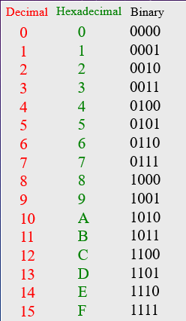
Hexadecimal number system
Large binary number can easily be converted to hexadecimal by grouping bits 4 at a time and writing the equivalent hexadecimal character.
Express 1001 0110 0000 1110₂ in hexadecimal:
Example
Group the binary number by 4-bits starting from the right. Thus, 960E
Solution
Notes:
Convert the following to hexadecimal: i) 250 ii) 325 iii) 1259

Slide 26
Hexadecimal Numbers
Decimal
Hexadecimal
Binary
Hexadecimal is a weighted number system. The column weights are powers of 16, which increase from right to left.
0 1 2 3 4 5 6 7 8 9 10 11 12 13 1415
0 1 2 3 4 5 6 7 8 9 A B C D E F
0000 0001 0010 0011 0100 0101 0110 0111 1000 1001 1010 1011 1100 1101 1110 1111
{
16³ 16² 16¹ 16⁰
Column weights
4096 256 16 1
Example
Express 1A2F₁₆ in decimal.
Solution
Start by writing the column weights:
4096 256 16 1
1 A 2 F₁₆
1(4096) + 10(256) +2(16) +15(1) =
6703₁₀

Slide 27
Hexadecimal
Base 16:
Digits 0 to 9 and letters A,B,C,D,E,F to represent the decimal numbers 10,11,12,13,14,15
Position 4 3 2 1
Weight 4096 256 16 1
Hex number 1 C A D
1CAD16 = 1 x 4096 + 12 x 256 + 10 x 16 + 13 x 1 = 7341₁₀

Slide 28
Decimal | Binary | Octal | Hexadecimal
0 | 0 | 0 | 0
1 | 1 | 1 | 1
2 | 10 | 2 | 2
3 | 11 | 3 | 3
4 | 100 | 4 | 4
5 | 101 | 5 | 5
6 | 110 | 6 | 6
7 | 111 | 7 | 7
8 | 1000 | 10 | 8
9 | 1001 | 11 | 9
10 | 1010 | 12 | A
11 | 1011 | 13 | B
12 | 1100 | 14 | C
13 | 1101 | 15 | D
14 | 1110 | 16 | E
15 | 1111 | 17 | F

Slide 29
Why Hexadecimal?
Let’s say you are writing a program, and a very important data is 1111101011011110₂.
Can anyone tell me what that number was again?
Now, try this: FADE₁₆.
What was that number again?
FADE₁₆. See?
Notes:
But why do we need to learn hexadecimal?
It’s easier to remember 4 characters than 16 characters!

Slide 30
Memorisation
Memorise this much, at least

Slide 31
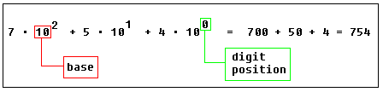
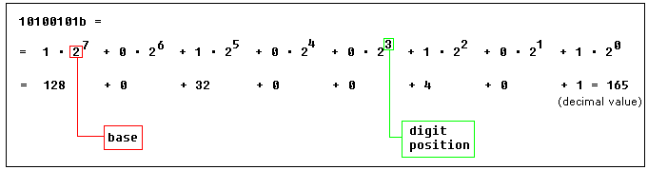
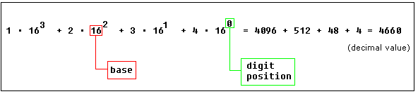
The Power of Bases
Base 10 (decimal), Base 2 (binary) & Base 16 (hexadecimal)
Notes:
Base & the weighting position.

Slide 32
Numbering Systems Conversion
Binary ⇨ Decimal (sum of all base 2 weighting)
Binary ⇨ Hexadecimal (4 bits grouping)
Binary ⇨ Octal (3 bits grouping)
Decimal ⇨ Binary (divide by 2)
Decimal ⇨ Hexadecimal (divide by 16)
Decimal ⇨ Octal (divide by 8)
Hexadecimal ⇨ Binary (equivalent 4 bits of each hexadecimal digit)
Hexadecimal ⇨ Decimal (sum of all base 16 weighting)
Octal ⇨ Binary (equivalent 3 bits of each digit)
Octal ⇨ Decimal (sum of all base 8 weighting)
Notes:
Refer to the exercises and will be discussed during Tutorial session.
Using calculator & without calculator.

Slide 33
Conversion of number system
Decimal to other base system
Step 1 : Divide the decimal number to be converted by the value of the new base.
Step 2: Get the remainder from Step 1 as the rightmost digit (least significant digit) of new base number.
Step 3: Divide the quotient of the previous divide by the new base.
Step 4: Record the remainder from Step 3 as the next digit (to the left) of the new base number.

Slide 34
Conversion of number system
Decimal to other base system
Repeat the Steps 3 and 4, getting remainders from right to left, until the quotient becomes zero in Step 3.
The last remainder thus obtained will be the most significant digit (MSD) of the new base number.

Slide 35
Conversion of number system
Decimal number : 29
Decimal to other base system
Step | Operation | Result | Remainder
Step 1 | 29/2 | 14 | 1
Step 2 | 14/2 | 7 | 0
Step 3 | 7/2 | 3 | 1
Step 4 | 3/2 | 1 | 1
Step 5 | 1/2 | 0 | 1
Decimal number : 29₁₀ = Binary Number : 11101₂

Slide 36
Conversion of number system
Converting a Number of Another Base to a Decimal Number
Method
Step 1 : Determine the column (positional) value of each digit
Step 2 : Multiply the obtained column values by the digits in the corresponding columns
Step 3 : Calculate the sum of these products.

Slide 40
BCD
Binary coded decimal (BCD) is a weighted code that is commonly used in digital systems when it is necessary to show decimal numbers such as in clock displays.
Decimal
Binary
BCD
0 1 2 3 4 5 6 7 8 9 10 11 12 13 1415
0000 0001 0010 0011 0100 0101 0110 0111 1000 1001 1010 1011 1100 1101 1110 1111
0000 0001 0010 0011 0100 0101 0110 0111 1000 1001 0000 0001 0010 0011 0100 0101
The table illustrates the difference between straight binary and BCD. BCD represents each decimal digit with a 4-bit code. Notice that the codes 1010 through 1111 are not used in BCD.
0001 0001 0001 0001 0001 0001

Slide 41
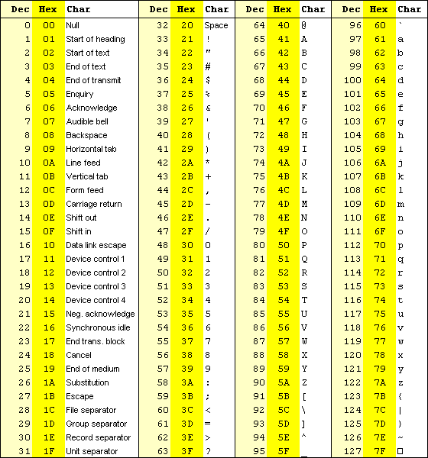
Table ASCII -I

Slide 42
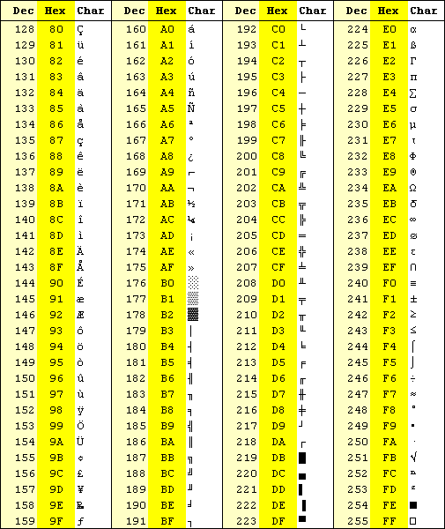
TABLE ASCII -II

Slide 43
Binary Addition
The rules for binary addition are
0 + 0 = 0 Sum = 0, carry = 0
0 + 1 = 0 Sum = 1, carry = 0
1 + 0 = 0 Sum = 1, carry = 0
1 + 1 = 10 Sum = 0, carry = 1
When an input carry = 1 due to a previous result, the rules are
1 + 0 + 0 = 01 Sum = 1, carry = 0
1 + 0 + 1 = 10 Sum = 0, carry = 1
1 + 1 + 0 = 10 Sum = 0, carry = 1
1 + 1 + 1 = 10 Sum = 1, carry = 1

Slide 44
Binary Subtraction
The rules for binary subtraction are
0 − 0 = 0
1 − 1 = 0
1 − 0 = 1
10 − 1 = 1 with a borrow of 1

Slide 46
Binary Multiplication

Slide 47
BINARY ADDITION – SELF TEST 1
11011 + 1001010 =
1011001 + 111010 =

Slide 48
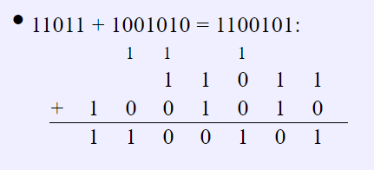
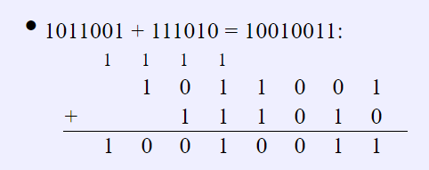

Slide 49
BINARY SUBTRACTION – SELF TEST 2
1000101 + 101100 =
1110110 + 1010111 =

Slide 50
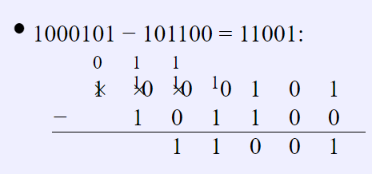
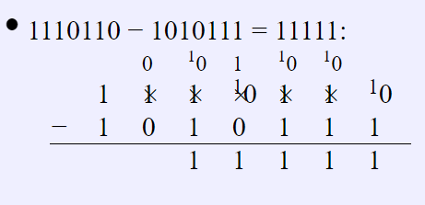

Slide 51
BINARY ADDITION (8-Bit Fixed Width Addition) – SELF TEST 3
1010110 + 110100 =
110001+ 11100100 =

Slide 52
